Slide 1


Slide 2
Introduction
Flip Flops are the fundamental Elements of Sequential circuits.
Bistable
Flip-flops are essentially 1-bit storage devices
Flip-flops have (normally) 2 complimentary outputs Q and Q.
Usually called as a ‘latch’.

Slide 3
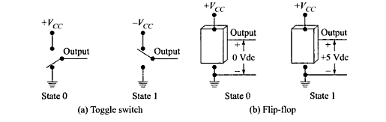
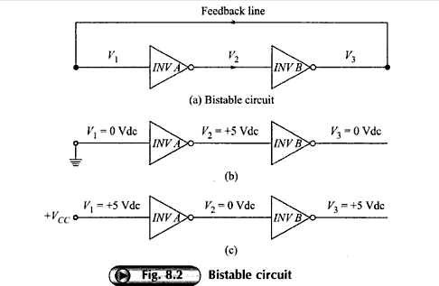
Bistable

Slide 4
Different types of Flip-flops
SR Flip-Flops
D Flip-flops
T Flip-flops
JK Flip-flops

Slide 5
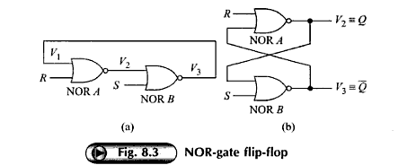
Nor gate latch

Slide 6
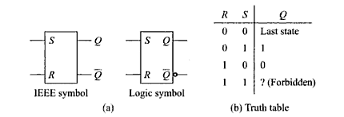
SR Flip-flops

Slide 7
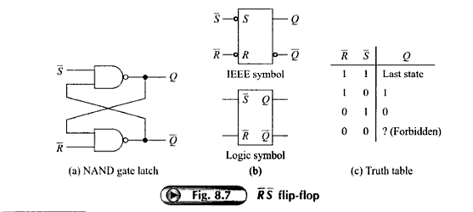
Nand gate latch

Slide 8
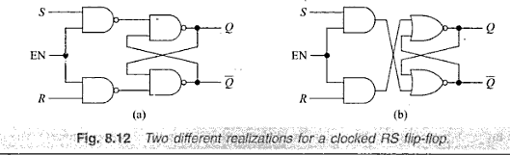
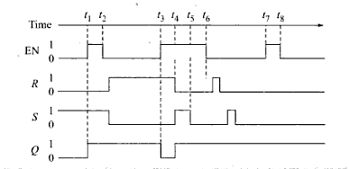
Gated flip-flops

Slide 9
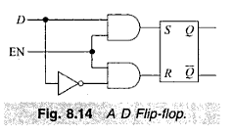
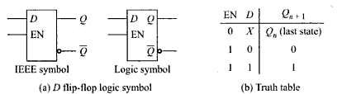
Clocked D flip-flop

Slide 10
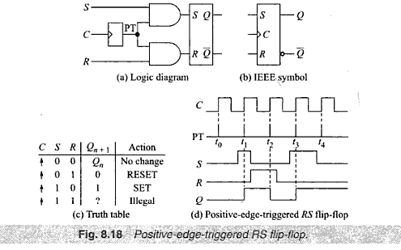
Edge Triggered RS flip-flop
Positive edge triggered SR flip-flop

Slide 11
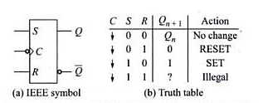
Negative Edge triggered SR flip-flop

Slide 12
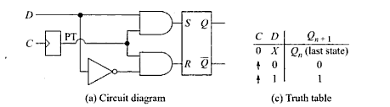
Edge Triggered D Flip-flop
Positive edge triggered D flip-flop

Slide 13
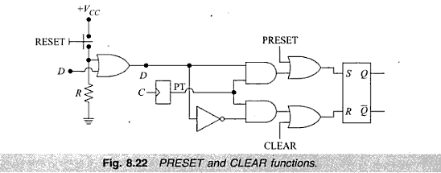
Preset/set & Clear/reset

Slide 14
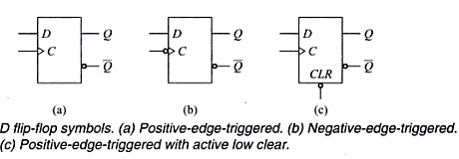

Slide 15
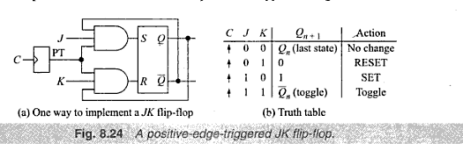
JK Flip flop

Slide 16
JK FF

Slide 17
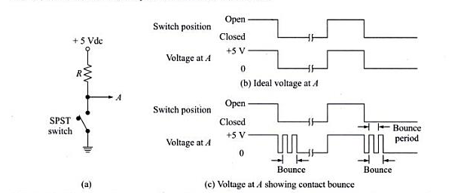
Switch contact bounce circuits

Slide 18
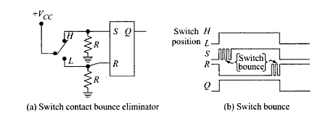
A Simple RS Latch De-bounce Circuit

Slide 19
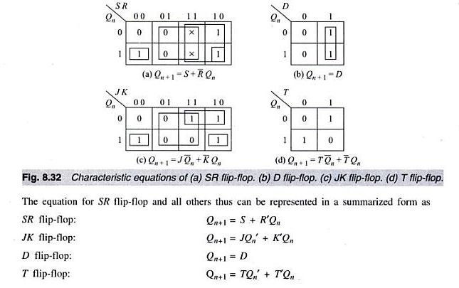
Various representation of Flip flops

Slide 20
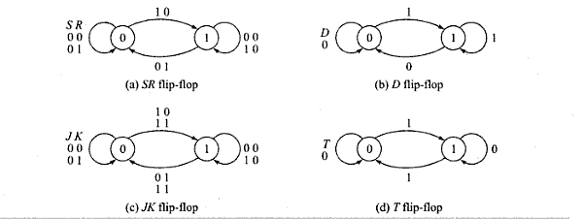
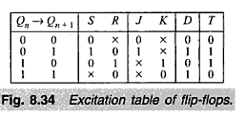
Flip flops as FSM

Slide 21
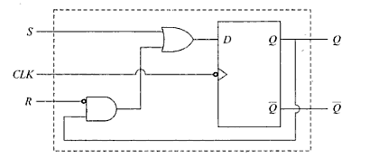
Conversion of flip flops
Show how D flip flop can be converted to SR flip-flop.

Slide 22
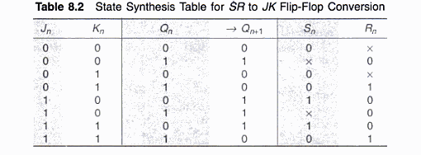
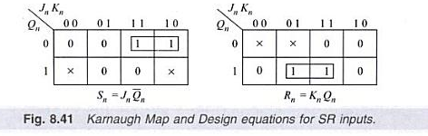
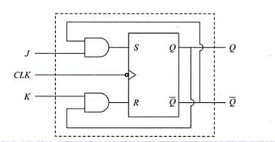
SR to JK flip flop

